Slide 1
ist 263
Intro to JavaScript

Slide 2
Agenda
What is JavaScript?
How do you use it?
1st JavaScript Program
Event Handling
Functions

Slide 3
What is Javascript

Slide 4
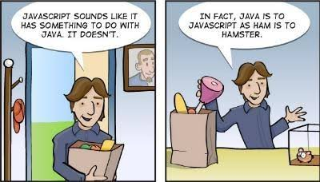

Slide 5
JavaScript is a scripting or programming language that allows you to implement complex features on web pages
Just like CSS and HTML JavaScript is interpreted in by your browser.

Slide 6
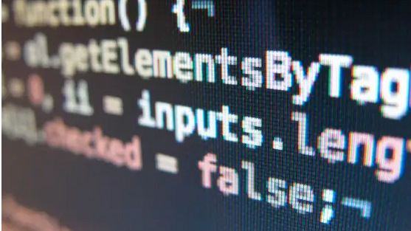
Most Popular Programming Language in the World
according to github https://www.businessinsider.com/most-popular-programming-languages-github-2019-11#1-javascript-10

Slide 7
What is JavaScript Used For?
Suggestions as you type (https://www.google.com/)
Validation on Forms (https://apply.commonapp.org/createaccount )
Dropdown navigation (https://soe.syr.edu/)
Accordion navigation on mobile aka hamburger nav (https://www.syracuse.edu)
Show or hide info with click of more button ()
Slideshows (https://www.everson.org/)
Much more!!!

Slide 8
How do you Use it?

Slide 9

Types of JavaScript
Embedded JavaScript (can be anywhere in HTML)
External JavaScript

Slide 10
How do you make a JavaScript file?
You only need to make a JavaScript file for external JavaScript
It is a text file just like .html and .css
Use .js as the file extension

Slide 11
1st JavaScript Program

Slide 12
Pointers
JavaScript is case sensitive myName is not the same as myname
Comments
// single line
/* multiple line */

Slide 13
Hello World Program
alert(‘Text I am sending in alert.’);

Slide 14
Event Handling

Slide 15
What are events?
Actions that happen in the browser like:
The page loading
A user clicking on something

Slide 16
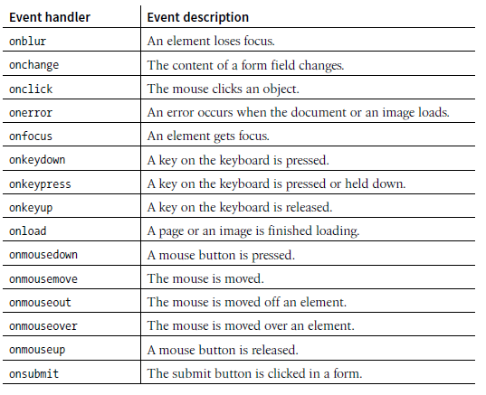

Slide 17
How to use events
Use them as an HTML attribute

Slide 18
Functions

Slide 19

A JavaScript function is a block of JavaScript code, that can be executed when "called" for.

Slide 20
Inspecting errors

Slide 21
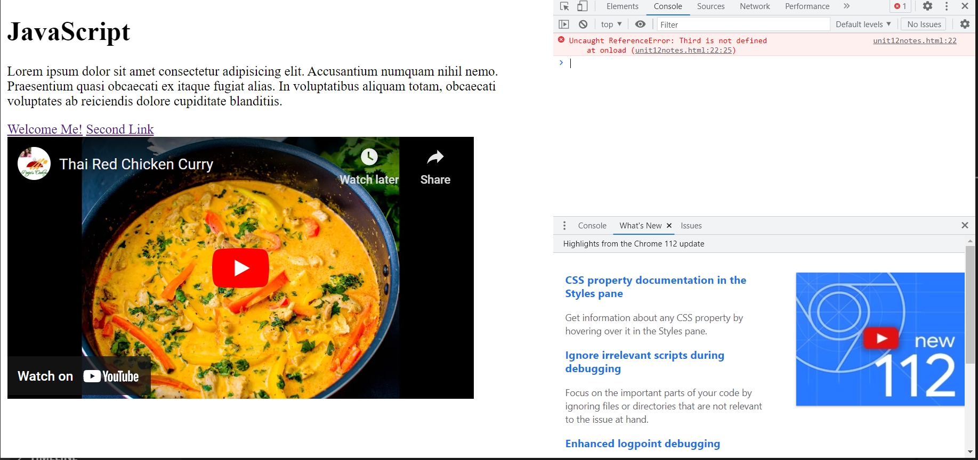
Inspecting for Errors

Slide 22
Participation

Slide 23
Create a Link that says – click for a message
Bring up an alert when the mouse rolls out this link.
The alert should say – My first JavaScript program!
Screen Shot Code for P12

